Slide 1

WPDD202: Webpage Design & Development
Version 2 – 18th December 2015

Slide 2
Accessing and manipulating data and databases and ethical considerations
Chapter E5

Slide 3
Data
Data
A necessity for almost any enterprise to carry out its business. Consists of raw facts, and when organized may be transformed into information
Database
A collection of data organized to meet users’ needs
Database management system (DBMS)
A group of programs that manipulate the database and provide an interface between the database and the user of the database or other application programs

Slide 4
Database definitions:
Def 1: A shared collection of logically related data, designed to meet the information needs of multiple users in an organization. The term database is often erroneously referred to as a synonym for a “database management system (DBMS)”. They are not equivalent and it will be explained in the next section.
Def 2: A collection of data: part numbers, product codes, customer information, etc. It usually refers to data organized and stored on a computer that can be searched and retrieved by a computer program.
Def 4: A collection of information organized and presented to serve a specific purpose. (A telephone book is a common database.) A computerized database is an updated, organized file of machine readable information that is rapidly searched and retrieved by computer.
Def 5: An organized collection of information in computerized format.
Def 7: A Computerized representation of any organizations flow of information and storage of data.

Slide 5
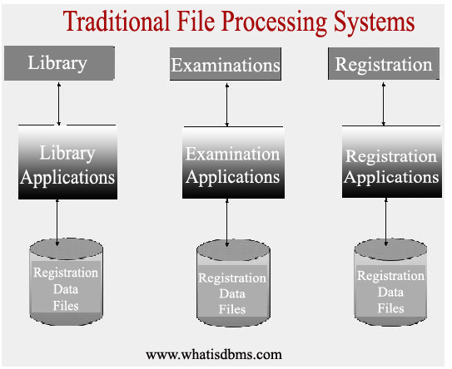
Databases and Traditional File Processing Systems
Fig. 1: A typical file processing environment

Slide 6
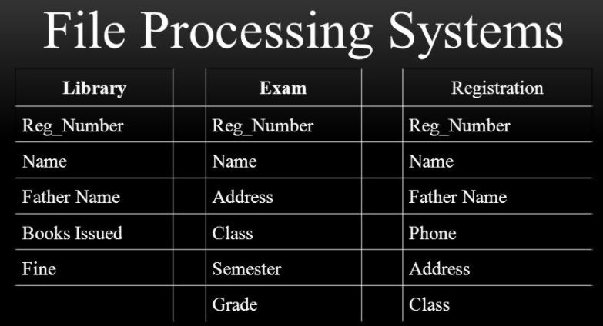
Duplication of Data Vulnerable to Inconsistency
Fig. 2: Some more problems in File System Environment

Slide 7
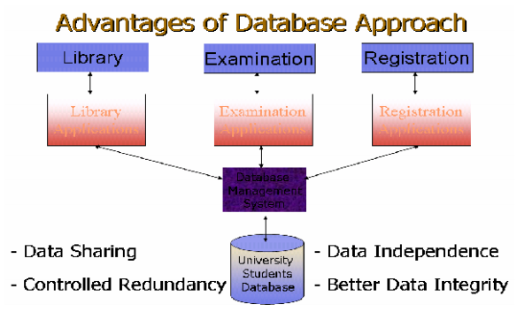
Advantages of Databases
Fig. 3: A typical Database System environment

Slide 8
Difference between Data and Information
Company: Super Soft Inc. Dept. Sales
Emp. Name | Age | Salary
John Smith | 23 | 5000
Marry Cooper | 24 | 4500
Garry Alan | 27 | 4200
Daniel Pine | 28 | 5200

Slide 9
Database Application:
Database Application is a program or group of programs which is used for performing certain operations on the data stored in the database. These operations may contain insertion of data into a database or extracting some data from the database based on a certain condition, updating data in the database, producing the data as output on any device such as Screen, disk or printer.

Slide 10
Database Management Systems:
Database management system is software of collection of small programs to perform certain operation on data and manage the data. Two basic operations performed by the DBMS are:
• Management of Data in the Database
• Management of Users associated with the database.

Slide 11
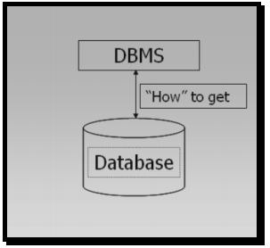
Typical Components of a Database Environment:
Database is used to store data and DBMS uses mechanisms to get data from the database
Fig. 4: DBMS and Database

Slide 12
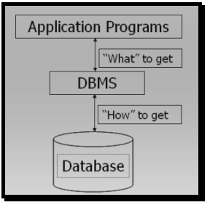
Application programs talk to DBMS and ask for the data required.
Fig. 5: Application Programs

Slide 13
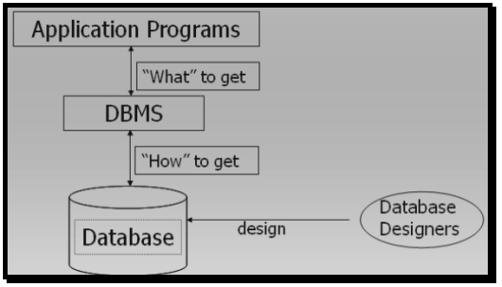
Database designers design (for large organizations) the database and install the DBMS for use by the users of the database in any specific organization.
Fig. 6: Database Designers

Slide 14
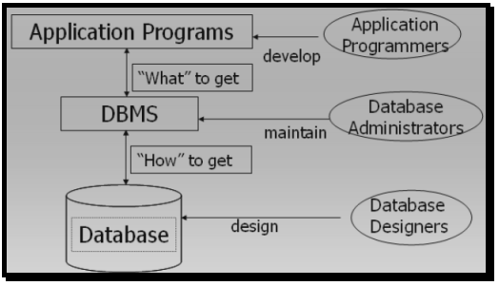
Once Database has been installed and is functioning properly in a production environment of an organization the Database Administrator takes over the charge and performs specific DBA related activities including:
Database maintenance
Database Backup
Grant of rights to database users
Monitoring of Running Jobs
Managing Print jobs
Ensuring quality of Service to all users
Fig. 7: Database Administrator

Slide 15
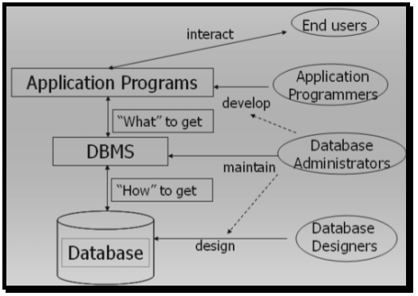
Fig. 8: Database Administration’s interaction with other users

Slide 16
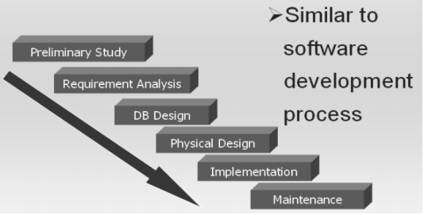
Database Development process

Slide 17
Data Modeling and Database Models
Data model
A map or diagram of entities and their relationships
Enterprise data modeling
Data modeling done at the level of the entire organization
Entity-relationship (ER) diagrams
A data model that uses basic graphical symbols to show the organization of and relationships between data

Slide 18
Example: Entity Relationship (ER) Diagram for a Customer Ordering Database

Slide 19
Last name
Attributes
Colour
Entities
First
name
Customer
1
Order
N
Product
Name
1:N one-to-many
relationship
Identification number
Identification number

Slide 20
Hierarchical Database Model
Hierarchical database model
A data model in which data are organized in a top-down, or inverted tree structure
Project 1
Department A
Department B
Department C
Employee
1
Employee
2
Employee
3
Employee
4
Employee
5
Employee
6

Slide 21
Network Data Model
Network data model
An expansion of the hierarchical database model with an owner-member relationship in which a member may have many owners
Project 1
Project 2
Department A
Department B
Department C

Slide 22
Relational Data Model
Data Table 1: Project Table
Data Table 2: Department Table
Project Number | Description | Dept. Number
155 | Payroll | 257
498 | Widgets | 632
226 | Sales manager | 598
Dept. Number | Dept. Name | Manager SSN
257 | Accounting | 421-55-99993
632 | Manufacturing | 765-00-3192
598 | Marketing | 098-40-1370
Data Table 3: Manager Table
SSN | Last Name | First Name | Hire Date | Dept. Number
005-10-6321 | Johns | Francine | 10-7-65 | 257
549-77-1001 | Buckley | Bill | 2-17-79 | 650
098-40-1370 | Fiske | Steven | 1-5-85 | 598

Slide 23
Data Definition Language
Data Definition Language (DDL)
A collection of instructions and commands used to define and describe data and data relationships in a specific database

Slide 24
Manipulating Data
Concurrency control
A method of dealing with a situation in which two or more people need to access the same record in a database at the same time
Data manipulation language (DML)
The commands that are used to manipulate the data in a database
Structured query language (SQL)
A standardized data manipulation language

Slide 25
On-Line Analytical Processing (OLAP)
On-line analytic processing (OLAP)
Access to multidimensional databases providing managerially useful display techniques
Now used to store and deliver data warehouse information
Data warehouse and OLAP
Provides top-down, query-driven analysis
Data mining
Provides bottom-up, discovery-driven analysis

Slide 26
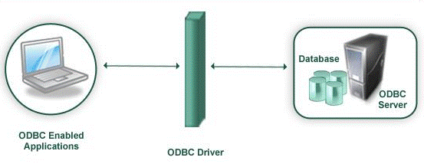
Open Database Connectivity (ODBC)
Open Database Connectivity (ODBC) is an Application Programming Interface (API) provided by Microsoft for accessing databases
Provides functions to insert, modify and delete data and obtain information from the database
Fig. 9: Open Database Connectivity (ODBC)

Slide 27
Database: Security Issues and Ethical Considerations
Legal and ethical issues regarding the right to access certain information. There are many laws governing privacy of information.
Policy issues at the governmental, institutional, or corporate level as to what kinds of information should not be made publicly available – for example, credit ratings and personal medical records
System-related issues such as the system levels at which various security functions should be enforced-- for example, whether a security function should be handled at the physical H/W, OS, or DBMS levels.
The need in some organizations to identify multiple security levels and to categorize the data and users based on these classified. The security policy of the organization with respect to permitting access to various classifications of data must be enforced.

Slide 28
Threats to Database
Threats to database result in the loss or degradation of some or all of the following security goals: integrity, availability, and confidentially.
Loss of integrity
Loss of availability
Loss of confidentially

Slide 29

kent.edu.au Kent Institute Australia Pty. Ltd. ABN 49 003 577 302 ● CRICOS Code: 00161E ● RTO Code: 90458 ● TEQSA Provider Number: PRV12051

